Slide 1






…..
Log in
FAQ
SERVICES
PROVIDERS
RECORDS
PAYMENT
Take charge of your health
Most trusted healthcare provider in the area.
Learn more
Healthcare plans we proudly work with.
Learn more
Come visit us at one of our multiple locations.
Learn more
Schedule an Appointment
CONTACT US
Phone Number
410-612-1010
Email Address
Mica@solutions.md
Mailing Address
7800 York Rd, Towson, MD 21204

Slide 2
…..
Log in
FAQ
SERVICES
PROVIDERS
RECORDS
PAYMENT
Log in to your account
New? Create an account.
Username
micahealthcare
Password
**********
Forgot username or password
Sign in

Slide 3
…..
Log in
FAQ
SERVICES
PROVIDERS
RECORDS
PAYMENT
Search
Providers near me

Slide 4




…..
FAQ
My account,
sign out.
SERVICES
PROVIDERS
RECORDS
PAYMENT
Hello MICA,
View Chart
Lab Results
Request for medical records
You have no upcoming scheduled appointments
Make an appointment
You have no unread messages
View messages
Create message
You have no outstanding balance
View bill history
Make payment

Slide 5
…..
Log in
FAQ
SERVICES
PROVIDERS
RECORDS
PAYMENT
Create an account
Last Name:
Solutions
First Name:
Mica
Email address:
Mica@solutions.md
Username:
MHSolutions
Password:
**********
Confirm password:
**********
Create account
Cancel

Slide 6

…..
My account,
sign out.
FAQ
SERVICES
PROVIDERS
RECORDS
PAYMENT
Thank you for creating a MICA account!

Slide 7
…..
Log in
FAQ
SERVICES
PROVIDERS
RECORDS
PAYMENT
Forgot Username?
Enter the email address associated with your account, first name, and last name and click "Recover Username" to have your username sent to your email address.
Email:
Mica@solutions.md
First Name:
Mica
Last Name:
Solutions
Recover Username
Forgot Password?
Enter the email address associated with your account, first name, and last name and click "Reset Password" to have a temporary password sent to your email address.
Sign in
Email:
Mica@solutions.md
First Name:
Mica
Last Name:
Solutions
Reset Password

Slide 8
…..
Log in
FAQ
SERVICES
PROVIDERS
RECORDS
PAYMENT
Username recovered
You have requested to recover your username. The username has been successfully recovered and sent to your email address. If you did not make these changes please contact our customer service at
1- 410-612-1012.
Sign in

Slide 9
…..
Log in
FAQ
SERVICES
PROVIDERS
RECORDS
PAYMENT
Password reset
You have requested to reset your password. A temporary password has been sent to your email address. Please log in using the temporary password and create a new password. If you did not make these changes please contact our customer service at
1- 410-612-1012.
Sign in

Slide 10


…..
My account,
sign out.
FAQ
SERVICES
PROVIDERS
RECORDS
PAYMENT
Schedule an Appointment
Patient details:
Appointment details:
Month:
Full name:
Mica Solutions
Day:
Phone #:
1-410-612-1010
Year:
Time:
Email:
Mica@solutions.md
Location:
Ap
Cancel
Book Appointment

Slide 11

…..
My account,
sign out.
FAQ
SERVICES
PROVIDERS
RECORDS
PAYMENT
CONFIRMED
Ap
Ap
Hello MICA, thank you for scheduling the following appointment:
Monday November 18, 2024 at 4:30pm
584 Newman Dr
Ellicott, MD, 21041
Add to calendar
Cancel
Reschedule

Slide 12

…..
My account,
sign out.
FAQ
SERVICES
PROVIDERS
RECORDS
PAYMENT
CANCELLATION CONFIRMED
Ap
Ap
The following appointment has been successfully cancelled:
Monday November 18, 2024 at 4:30pm
584 Newman Dr
Ellicott, MD, 21041

Slide 13
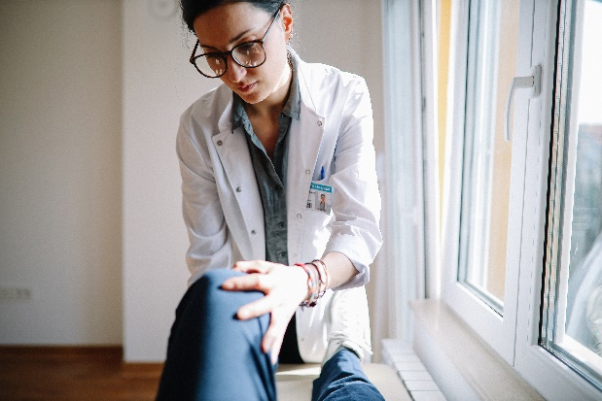

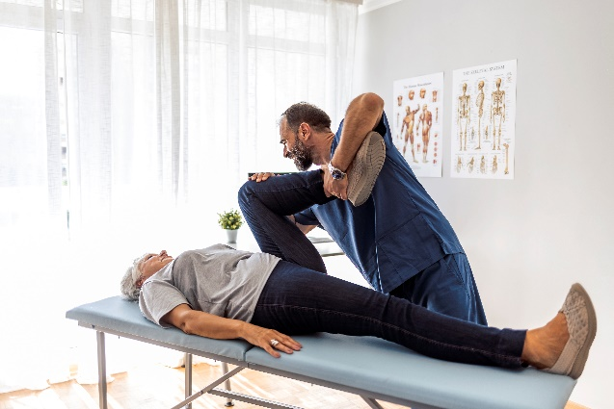
…..
Log in
FAQ
SERVICES
PROVIDERS
RECORDS
PAYMENT
Physical Examination
Lab Test
Rehabilitation
Schedule an Appointment now!

Slide 14

…..
Log in
FAQ
SERVICES
PROVIDERS
RECORDS
PAYMENT
Type a Condition, a Doctor's name, or a Specialty
Find a doctor

Slide 15
…..
My account,
sign out.
FAQ
SERVICES
PROVIDERS
RECORDS
PAYMENT
Patient records database
Patient ID | Last Name | First Name | Gender | Date of Birth | Primary Care Physician | Phone number | Email
5482469513 | Walker | Jonathan | Male | 12/02/1956 | Dr. Annablle Helveston | 410-548-3154 | jwalker@*****
2144683243 | Wise | Cordelia | Female | 03/11/1977 | Dr. Haven Cauley | 310-485-6482 | Cwise1@*****
2468165749 | Odling | Leo | Male | 01/01/1999 | Dr. Romeo Schnabl | 240-948-0482 | LeoD07@*****
4861532495 | Faulker | Ayesha | Female | 07/30/1988 | Dr. Ethel Bourland | 301-975-2158 | AFaul88@*****
0245863429 | Russo | Marshall | Male | 10/28/1980 | Dr. Ethel Bourland | 619-498-3144 | Russo@*****
8954132564 | Bloom | Diego | Male | 11/26/1987 | Dr. Haven Cauley | 245-354-2068 | Bl00m33@*****
3548951354 | Horton | Ivy | Female | 05/07/2000 | Dr. Romeo Schnabl | 401-579-3201 | Ivy_77@*****
3248951324 | Mcgowan | Alisa | Female | 09/15/1869 | Dr. Annablle Helveston | 562-649-0157 | Alisa23@*****
8762419201 | Lee | Kylie | Female | 04/21/1990 | Dr. Ethel Bourland | 485-302-4810 | KLee1990@****
6485130679 | Anderson | Sebastian | Male | 08/14/2005 | Dr. Annablle Helveston | 975-248-6482 | Sander08@****
0135954621 | Ramsey | Roman | Male | 07/04/1989 | Dr. Haven Cauley | 476-648-0235 | Roman45@****
Notes:
When a customer uses this function, they can only view their patient record.
For healthcare providers, they can view the whole database.

Slide 16


…..
My account,
sign out.
FAQ
SERVICES
PROVIDERS
RECORDS
PAYMENT
Patient records database
Edit
Personal Information
Name:
Johnathan Walker
Phone Number:
410-548-3154
Gender:
Email address:
jwalker@*****
Date of Birth:
Age:
Personal Information
Diagnosis
Treatment
Medical History
Appointments
Insurance
Marital Status:
Nationality:
Occupation:
Retired
Address:
Street:
813 Elm St
City:
Ellicott
State:
Maryland
Zip code:
21045
Notes:
When a customer uses this function, they can only view their patient record.
For healthcare providers, they can view the whole database.

Slide 17

…..
My account,
sign out.
FAQ
SERVICES
PROVIDERS
RECORDS
PAYMENT
Patient records database
Personal Information
Name:
Johnathan Walker
Phone Number:
410-548-3154
Gender:
Email address:
jwalker@*****
Date of Birth:
Age:
Personal Information
Diagnosis
Treatment
Medical History
Appointments
Insurance
Marital Status:
Nationality:
Occupation:
Retired
Address:
Street:
813 Elm St
City:
Ellicott
State:
Maryland
Zip code:
21045
Save
Cancel
Notes:
When a customer uses this function, they can only view their patient record.
For healthcare providers, they can view the whole database.

Slide 18
…..
My account,
sign out.
FAQ
SERVICES
PROVIDERS
RECORDS
PAYMENT
Patient records database
Personal Information
Your records have been
successfully saved!
Name:
Johnathan Walker
Phone Number:
410-548-3154
Gender:
Male
Email address:
jwalker@*****
Date of Birth:
07/15/1997
Age:
67
Personal Information
Diagnosis
Treatment
Medical History
Appointments
Insurance
Marital Status:
Single
Married
Divorced
Nationality:
American
Occupation:
Retired
Address:
Street:
813 Elm St
City:
Ellicott
State:
Maryland
Zip code:
21045
Notes:
When a customer uses this function, they can only view their own record.
For healthcare providers, they can view the whole database.

Slide 19



…..
Log in
FAQ
SERVICES
PROVIDERS
RECORDS
PAYMENT
Pay your bill
Pay your bill online through your MICA account
Call
1-410-612-1010 to pay your bill through the phone
Mail your
payment to:
MICA Healtchcare Solutions
7800 York Rd
Towson, MD 21204
Please note:
If you have any questions please contact our billing customer service at 1-410-612-1015.

Slide 20
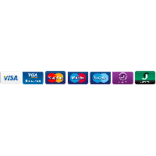



…..
My account,
sign out.
FAQ
SERVICES
PROVIDERS
RECORDS
PAYMENT
Pay your bill online
Payment Method
Billing Information
Confirm Payment
Complete payment details below
Pay using
Card number
MM/ YY
Security code
Continue

Slide 21
…..
My account,
sign out.
FAQ
SERVICES
PROVIDERS
RECORDS
PAYMENT
Pay your bill online
Payment Method
Billing Information
Confirm Payment
Billing Address
Full Name
Street Name
City
State
Zipcode
Continue

Slide 22
…..
My account,
sign out.
FAQ
SERVICES
PROVIDERS
RECORDS
PAYMENT
Pay your bill online
Payment Method
Billing Information
Confirm Payment
Confirm your payment
Details
Date 11/16/2024
Payment method Visa
Card number **** **** **** 8163
Cardholder name Jonathan Walker
Email jwalker@*****
Total Amount $414.12
Cancel
Confirm

Slide 23

…..
My account,
sign out.
FAQ
SERVICES
PROVIDERS
RECORDS
PAYMENT
Thank you for your payment!
We’ve sent you a digital copy of your receipt in your email.

Slide 24
…..
Log in
FAQ
SERVICES
PROVIDERS
RECORDS
PAYMENT
FREQUENTLY ASKED QUESTIONS (FAQ)
I forgot my username and password. How do I recover them?
There are multiple ways to recover your username or password. First, on the log in tab, you can click on “forgot username or password” and follow the prompts to recover them using your email address. Second, you can give us a call at 1-612-1012 and a representative will be able to help you recover them.
Which insurance provider do you accept?
We work with multiple insurance providers to accommodate as many patients as possible. Click here to view the different insurance providers.
How can I pay my bills?
You can either pay your bills online, through the phone, or by emailing it to us directly. Click here to view the different options to pay your bill.
I recently moved, can I visit a different location?
We have multiple locations around the state of Maryland, you can visit us at any of our locations.

Slide 25
…..
My account,
sign out.
FAQ
SERVICES
PROVIDERS
RECORDS
PAYMENT
Sign out of MICA?
Cancel
Log out
You can always sign back in at any time.

Slide 26

…..
Log in
FAQ
SERVICES
PROVIDERS
RECORDS
PAYMENT
Thank you for choosing MICA, see you soon!

